Slide 1



Noida Institute of Engineering and Technology, Greater Noida
Panchayati Raj and Rural Administration
Unit: 3
Rural Development: Administration and Planning (KHU701)
Ajay Gangele
Assistant Professor
Department of MBA
BTECH 4th Year (7th Semester)

Slide 2

Index/Content
S. No. | Index
1. | Name of Subject with code, Course and Subject Teacher
2. | Brief Introduction of Faculty member with Photograph
3. | Evaluation Scheme
4. | Syllabus
5. | Branch wise Application
6. | Course Objective(s)
7. | Course Outcome(s)
8. | Program Outcomes (POs)
9. | COs and POs Mapping

Slide 3
Index/Content
S. No. | Index
10. | Program Specific Outcomes (PSOs)
11. | Cos and PSOs Mapping
12. | Program Educational Objectives (PEOs)
13. | Result Analysis
14. | End Semester Question paper Templates
15. | Prequisite/Recap
16. | Brief Indtroduction about the Subject with Videos
17. | Unit Contents
18. | Unit Objectives
19. | Topic Objectives/Topic Outcome

Slide 4
Index/Content
S. No. | Index
20. | Lecture related to topic
21. | Daily Quiz
22. | Weekly Assignment
23. | Topic Links
24. | MCQs
25. | Glossary Questions
26. | Old question papers
27. | Expected Questions
28. | Recap of unit

Slide 5


Faculty Profile
Faculty Name: Ajay Gangele
Designation: Assistant Professor
Department: MBA
Email ID: ajay.gangele@niet.co.in
Qualification: B.Sc. MBA,UGC NET,PhD(P)
Specialisation: Marketing and HR
Research Area: Marketing
Teaching Area: Marketing and HR
Total Experience: 17 Years

Slide 6

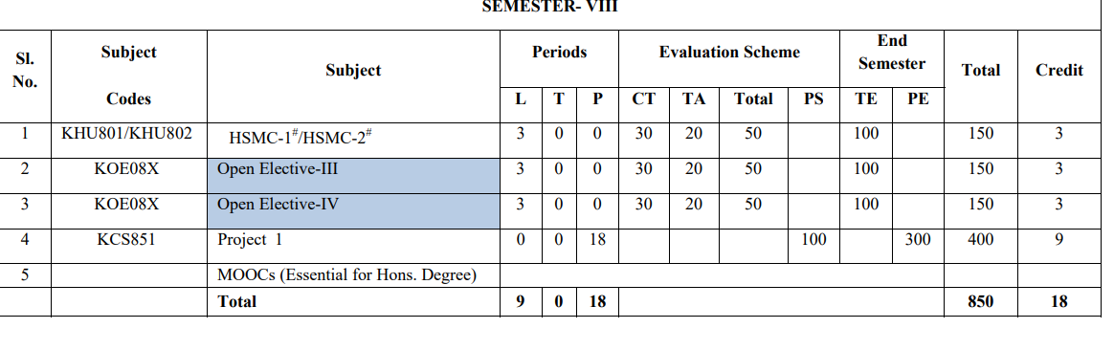
Evaluation Scheme

Slide 7

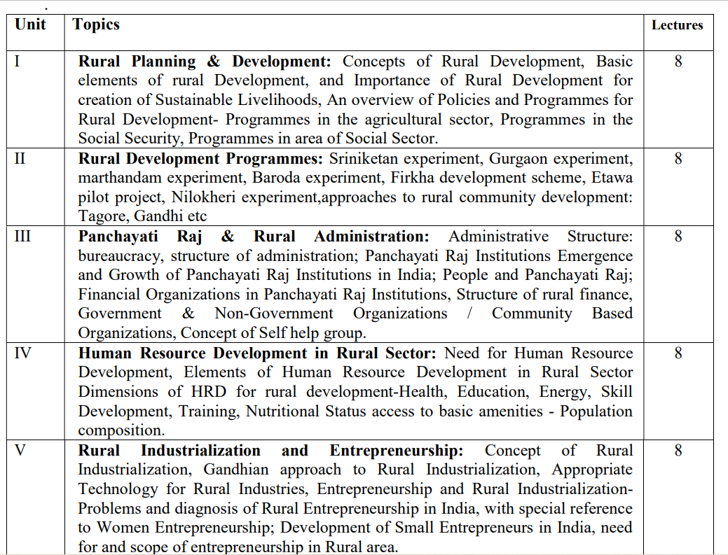
Syllabus
Syllabus

Slide 8
Branch wise Applications
Rural development course offers an understanding of how strategies for the management of rural areas and their implementation are planned and executed.
There are further courses at graduate and post graduate levels for people who are interested in working in rural development co-operatives and development organizations.
The emergence of capitalism in rural areas can be understood as Rural Development.
It basically refers to the modernization and development of rural cities and areas.
It is also concerned with the socio-economic development of rural people.
Hence, those who aspire to pursue a rural development course will get to learn the same during the years of their study.

Slide 9

Course Objectives
To Understand the definitions, concepts and components of Rural Development
To Know the importance, structure, significance, resources of Indian rural economy
To help them in developing the ability to have a clear idea about the area development programmes and its impact.
To be able to acquire knowledge about rural entrepreneurship
To develop the understanding about the using of different methods for human resource planning

Slide 10

Course Outcomes
CO1: Understand the definitions, concepts and components of Rural Development | Understand ( K 2)
CO2: Know the importance, structure, significance, resources of Indian rural economy. | Apply ( K 3)
CO3: Develop the ability to have a clear idea about the area development programmes and its impact. | Analyzing ( K 4)
CO4: Able to acquire knowledge about rural entrepreneurship. | Applying ( K 3)
CO5: Understand about the using of different methods for human resource planning | Understand ( K 2)

Slide 11

Program Outcomes
PO1 Engineering knowledge
PO2 Problem analysis
PO3 Design/development of solutions
PO4 Conduct investigations of complex problems
PO5 Modern tool usage
PO6 The engineer and society
PO7 Environment and sustainability
PO8 Ethics
PO9 Individual and team work
PO10 Communication
PO11 Project management and finance
PO12 Life-long learning

Slide 12

CO-PO Mapping
PO CO | PO1 | PO2 | PO3 | PO4 | PO5 | PO6 | PO7 | PO8 | PO9 | PO10 | PO11 | PO12
CO 1 | M |  |  | M |  |  |  |  |  |  |  | M
CO 2 |  |  |  |  |  |  | H | M |  |  |  | H
CO 3 |  | M |  |  |  |  |  | H |  |  |  | M
CO 4 |  |  |  |  |  |  |  |  | M |  |  | H
CO 5 |  |  |  |  |  |  | M

Slide 13

Program Specific Outcomes
S.No. | Program Specific Outcomes | PSO Description
1 | PSO1 | Ability to design manufacturing processes, products, the equipment, tooling and necessary environment for the manufacture of products that meet specific material and other requirements.
2 | PSO2 | Ability to use design, manufacturing and industrial engineering software packages to formulate and solve real time issues.
3 | PSO3 | Ability to analyze, synthesis and control manufacturing operations using statistical methods and to create competitive advantage through the application of manufacturing planning, strategy, quality and control concepts.

Slide 14
CO and PSO Mapping
Core Courses | Apply knowledge of management theories and practice to solve business problem | Foster Analytical and critical thinking abilities for data-based decision making. | Ability to develop Value based Leadership ability. | Ability to understand, analyze and communicate global, economic, legal, and ethical aspects of business. | Team environment
CO1:Understand the definitions, concepts and components of Rural Development | H | L | L | L | M
CO2: Know the importance, structure, significance, resources of Indian rural economy. | M | H | L | M | M
CO3: Develop the ability to have a clear idea about the area development programmes and its impact | L | L | H | M | H
CO4:Able to acquire knowledge about rural entrepreneurship | L | L | M | H | M
CO5: Understand about the using of different methods for human resource planning | L | L | L | M | H
Dr. Navneesh Tyagi KHU701_RD Unit 4
CO5: Understand about the using of different methods for human resource planning | L | L | L | M | H

Slide 15
Program Educational Objectives
PEO1: Able to apply sound knowledge in the field of information technology to fulfill the needs of IT industry.
PEO2: Able to design innovative and interdisciplinary systems through latest digital technologies.
PEO3: Able to inculcate professional and social ethics, team work and leadership for serving the society.
PEO4: Able to inculcate lifelong learning in the field of computing for successful career in organizations and R&D sectors.

Slide 16
Result Analysis
Result Awaited

Slide 17

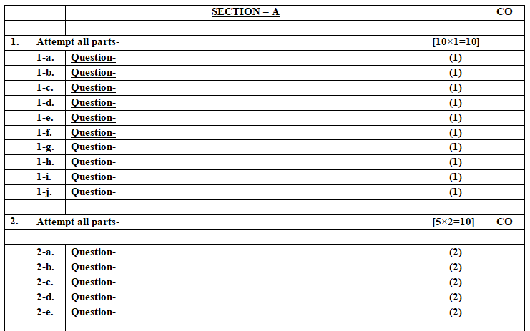
End Semester Question Paper Template

Slide 18

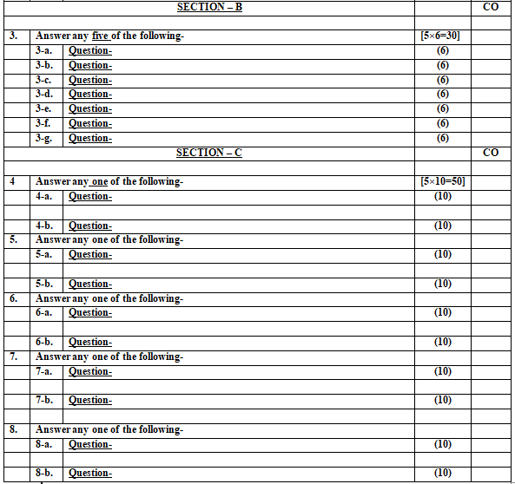
End Semester Question Paper Template

Slide 19
Prerequisites/ recap
Students must have the basic knowledge of rural administration and development.
Understanding and knowledge of various rural development experiments.

Slide 20

Introduction of subject with video links
https://www.youtube.com/watch?v=kVE0RaWAGCM
https://www.youtube.com/watch?v=2VFtjJy87Mc
https://www.youtube.com/watch?v=5Jif4nKDVxA
https://www.youtube.com/watch?v=z19BhR9hsjU
https://www.youtube.com/watch?v=z19BhR9hsjU&t=352s

Slide 21
Unit Content
Administrative structure: Bureaucracy, structure and administration.
Panchayat Raj Institutions Emergence and Growth of Panchayati Raj Institutions in India.
People and Panchayati Raj
Financial Organizations in Panchayati Raj Institutions
Structure of Rural finance
Government and non- government organisations/community-based organisations.
Concept of self-help group.

Slide 22
Session Learning Objective with CO mapping
Administrative structure: Bureaucracy
Structure and administration
Topic | Course Outcome
Understanding Administrative structure: Bureaucracy Structure and administration | CO3

Slide 23
Panchayati Raj
Panchayati Raj is a system of rural local self-government in India.
It has been established in all the states of India by the acts of the state legislature to build democracy at the grass root level.
It is entrusted with rural development and was constitutionalized through the 73rd Constitutional Amendment Act of 1992.

Slide 24
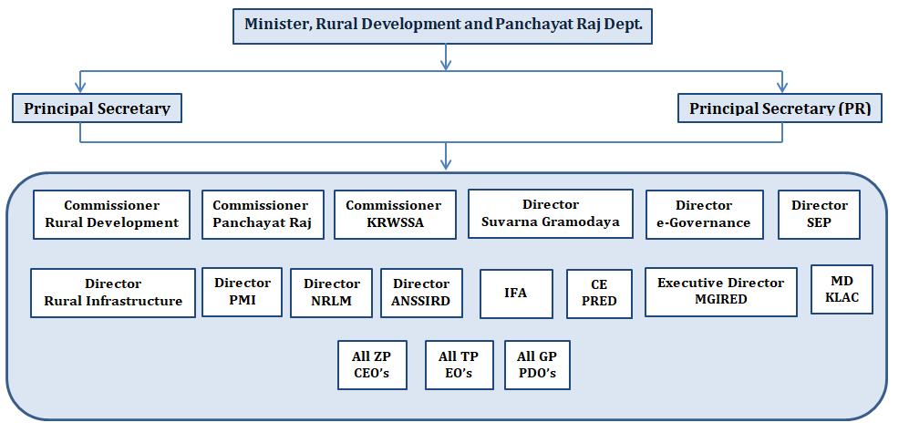
Panchayati Raj Structure

Slide 25
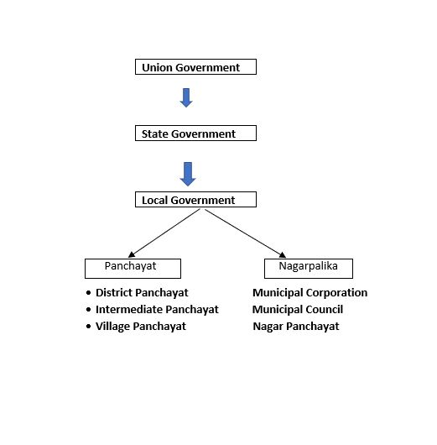
Panchayati Raj Structure

Slide 26
Panchayati Raj Structure
The system has three levels:
Gram Panchayat (Village level),
Mandal Parishad or Block Samiti or Panchayat Samiti (Block level)
Zila Parishad (District level)

Slide 27
Recap
In this topic, we studied the structure, administration of Panchayati Raj.

Slide 28
Daily Quiz
State the three levels of Panchayati raj structure.
Make a flow chart to explain the bureaucratic model of Panchayati raj in India.
Define Panchayati Raj.

Slide 29
Session Learning Objective with CO mapping
Panchayat Raj Institutions Emergence and Growth of Panchayati Raj Institutions in India.
Topic | Course Outcome
Getting to know about Panchayati raj institutions and their growth | CO3

Slide 30
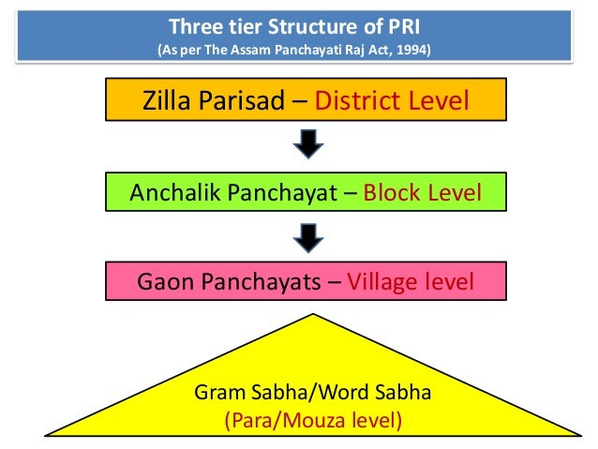
Panchayati Raj Institutions (PRIs)

Slide 31
Emergence of Panchayati Raj System
Panchayati Raj is a system of rural local self-government in India.
It has been established in all the states of India by the acts of the state legislature to build democracy at the grass root level.
It is entrusted with rural development and was constitutionalized through the 73rd Constitutional Amendment Act of 1992

Slide 32
Emergence of Panchayati Raj System
Panchayati Raj Institution (PRI) is a system of rural local self-government in India.
Local Self Government is the management of local affairs by such local bodies who have been elected by the local people.

Slide 33
Emergence of Panchayati Raj System
PRI was constitutionalized through the 73rd Constitutional Amendment Act, 1992 to build democracy at the grass roots level and was entrusted with the task of rural development in the country.
In its present form and structure PRI has completed 26 years of existence. However, a lot remains to be done in order to further decentralization and strengthen democracy at the grass root level.

Slide 34
Emergence of Panchayati Raj in India
Vedic Era: In the old Sanskrit scriptures, word ‘Panchayatan’ has been mentioned which means a group of five persons, including a spiritual man.
Epic Era indicates the two great epic periods of India, that is, the Ramayana and the Mahabharata.
The study of Ramayana indicates that the administration was divided into two parts - Pur and Janpad or city and village.

Slide 35
Emergence of Panchayati Raj in India
As per the Mahabharata, over and above the village, there were units of 10, 20, 100, and 1,000 village groups.
‘Gramik’ was the chief official of the village, ‘Dashap’ was the chief of ten villages, Vinshya Adhipati, Shat Gram Adhyaksha and Shat Gram Pati were the chiefs of 20, 100, and 1,000 villages, respectively.

Slide 36
Emergence of Panchayati Raj in India
Ancient Period: There is a mention of village panchayats in Kautilya’s Arthashastra. The town was referred to as Pur and its chief was the Nagarik.
Medieval Period: During the Sultanate period, the Sultans of Delhi divided their kingdom into provinces called ‘Vilayat’.

Slide 37
Emergence of Panchayati Raj in India
British Period: Under the British regime, village panchayats lost their autonomy and became weak.
The famous Mayo’s resolution of 1870 gave impetus to the development of local institutions by enlarging their powers and responsibilities.

Slide 38
Growth of Panchayati Raj in India
Local self-government institutions received a boost with the appointment of the Royal Commission on centralisation in 1907 under the Chairmanship of C.E.H. Hobhouse.
The commission recognized the importance of panchayats at the village level.
It is in this backdrop that the Montagu Chelmsford reforms of 1919 transferred the subject of local government to the domain of the provinces.

Slide 39
Growth of Panchayati Raj in India
However, by 1925, eight provinces had passed the Panchayat Acts and by 1926, six native States had also passed panchayat laws. Local bodies were given more powers and functions to impose taxes were reduced. But, the position of the local self-government institutions remained unaffected.

Slide 40
Growth of Panchayati Raj in India
Post–Independence Period: After the Constitution came into force, Article 40 made a mention of panchayats and Article 246 empowers the state legislature to legislate with respect to any subject relating to local self-government.

Slide 41
Growth of Panchayati Raj in India
After independence, as a development initiative, India had implemented the Community Development Programmes (CDP) on the eve of Gandhi Jayanti, the 2nd October, 1952 under the major influence of the Etawah Project undertaken by the American expert, Albert Mayer.
In 1957, the National Development Council constituted a committee headed by Balwant Rai Mehta to look into the working of community development programme.
As a result of this scheme of democratic decentralization was launched in Rajasthan on October 2, 1959.

Slide 42
Growth of Panchayati Raj in India
Ashok Mehta Committee in 1977 recommended a two-tier Panchayat Raj institutional structure consisting of Zilla Parishad and Mandal Panchayat.
The G.V.K. Rao Committee (1985) recommended making the “district” as the basic unit of planning and also holding regular elections while the L.M.Singhvi committee recommended providing more financial resources and constitutional status to the panchayats to strengthen them.

Slide 43
Growth of Panchayati Raj in India
73rd and 74th Constitutional Amendments were passed by Parliament in December, 1992. Through these amendments local self-governance was introduced in rural and urban India.
The Acts came into force as the Constitution (73rd Amendment) Act, 1992 on April 24, 1993 and the Constitution (74th Amendment) Act, 1992 on June 1, 1993.

Slide 44
Recap
In this topic, we studied the structure of Panchayati raj institutions.
We have also studied the growth and emergence of Panchayati raj in India.

Slide 45
Daily Quiz
Define Panchayati Raj institutions.
Name the Panchayati raj institutions.
Elaborate the three-tier structure of Panchayati Raj institutions in India.
Highlight the emergence and growth of Panchayati Raj institutions.

Slide 46
Session Learning Objective with CO mapping
Financial Organizations in Panchayati Raj Institutions
Topic | Course Outcome
Financial Organizations in Panchayati Raj Institutions | CO3

Slide 47
Financial organizations in Panchayati raj
The finances of Gram Panchayat come from both the state and the federal government. Grants from the Central Finance Commission are currently one of the most important sources of funds for Gram Panchayats.
In addition, grants from state finance commissions are also available. Most Gram Panchayats have largely untapped revenue sources as well. Land revenue, vehicle tax, tax on industries located within the village's geographical boundaries, toll tax, and festival tax are all sources of funding for the gram panchayat.

Slide 48
Ways to fund Panchayat
Panchayats in our country generally receive funds in the following ways:
Grants from the Union Government based on the Central Finance Commission's recommendations, as per Article 280 of the Constitution;
Devolution from the State Government in accordance with Article 243, based on the recommendations of the State Finance Commission;

Slide 49
Ways to fund Panchayat
State government loans and grants;
Allocations for specific programs under Centrally Sponsored Schemes and Additional Central Assistance;
Generation of Internal Resources (tax and non-tax).

Slide 50
Recap
In this topic, we studied the role of financial institutions in Panchayat raj.
We also studied the ways to fund panchayat.

Slide 51
Daily Quiz
State the role of state finance commissions in Panchayati raj.
Elucidate the ways to fund panchayat.
Elaborate the importance of financial institutions in Panchayati Raj.

Slide 52
Session Learning Objective with CO mapping
Understanding the structure of Rural finance
Topic | Course Outcome
Structure of Rural finance | CO3

Slide 53
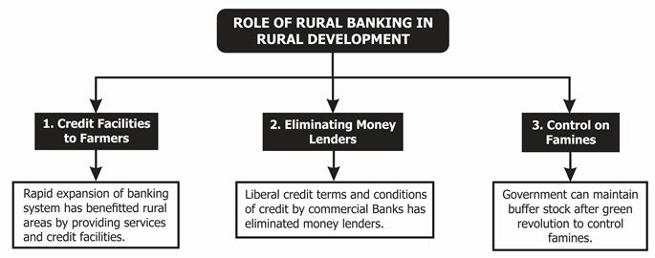
Rural Finance

Slide 54
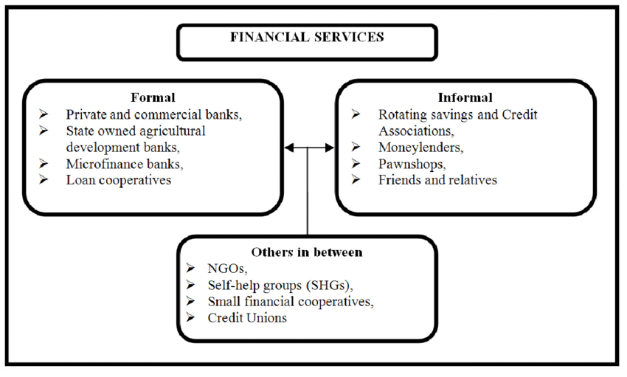
Rural Finance

Slide 55
Recap
In this topic, we studied the concept of rural financing.
We also studied the rural banking and financial services in rural development.

Slide 56
Daily Quiz
Define rural finance.
Elucidate the role of rural banking in rural development.
Highlight the role of formal and informal financial services in rural development.

Slide 57
Session Learning Objective with CO mapping
Understanding the concept and application of self-help groups in rural setup.
Topic | Course Outcome
Self-help groups | CO3

Slide 58
Community based financial organization
Community Development had a long history in India even before the launching of the Community Development Programme (CDP) during the period of 2nd October 1952.
A number of isolated experiments before independence period influenced by western liberal thought organized voluntary movements which had a powerful impact in different parts of country towards social and economic development.
Such movements like
Arya Samaj (1875) founded by Swami Dayananda,
Rama Krishna Mission (1897) founder by Swami Vivekananda,
Theosophical Movement (1893) founded by Annie besent,
Sarvodaya Movement(1920) by Mahatma Gandhi.

Slide 59
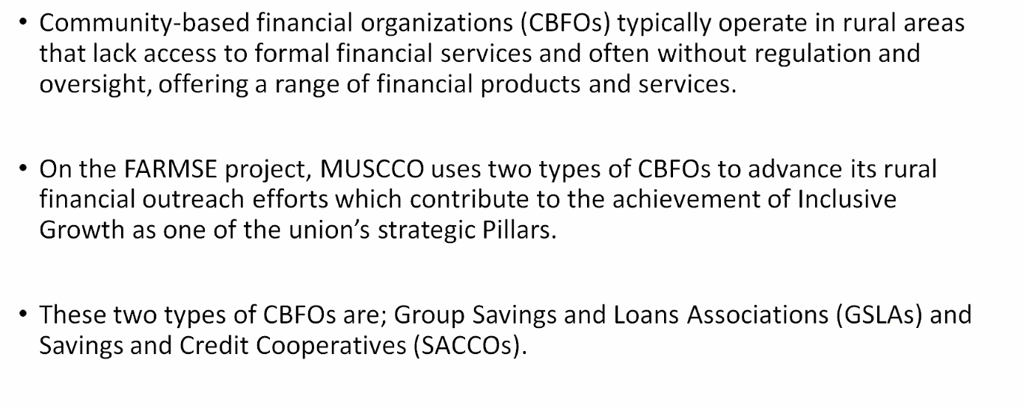
Community based financial organization

Slide 60
Characteristics of community based organizations :
Voluntary membership
Participatory planning
Resource mobilization and utilization
Self management
Net working
Monitoring and self-evaluation
Sustainability etc

Slide 61
Objectives of community based organizations
To reduce the dependence on others.
To take appropriate decision to solve the problems at right time.
To increase the self confidence and skills among the members.
To take mutual cooperation between the each members.
To gain the significance and respectability.
To increase the self-empowerment.
To bring awareness among the members about different policies and programmes of government and local bodies

Slide 62
Objectives of community based organizations
To take initiative to organize the different rural development programmes.
To bring awareness among members about mobilization of resources and utilization.
To bring awareness among members about working efficiently of other organizations.
To increase the modern scientific knowledge about the agriculture, animal husbandry, allied activities, rural artisans, etc., among the members.
To undertaken the income generation activities in the society.
To reduce the poverty in the society

Slide 63
Major Community Based Organizations
Traditional Associations: These associations exit in certain tribal, ethnic and caste groups, eg tribalpanclayats for tribal self-rule.
Religions Associations: eg. Hinduism, Buddhism, Jainism, Sikhism, Christianity and Islam.
Membership Associations ;eg. Trade unions, peasants organizations etc.
Voluntary Organizations : which organizations are registered under society Acts of 1860 section XXI andmodification of Society Acts.

Slide 64
Major Community Based Organizations
Watershed Associations.
Water user Associations.
Vanasamrakshana Associations.
Mother Committees.
Education Committees.
School Management Committees.
Self Help Groups.
Youth Associations.
Mahila Mandals.
Cultural Associations etc

Slide 65
Recap
In this topic, we have studied the emergence and relevance of community based organisations.
Some major community based organisations are also discussed.

Slide 66
Daily Quiz
Explain the relevance of community-based financial organizations.
Elaborate the objectives of community based organization.
Highlight the inception of community based organizations.

Slide 67
Session Learning Objective with CO mapping
Understanding the concept and application of self-help groups in rural setup.
Topic | Course Outcome
Self-help groups | CO3

Slide 68
Self Help Group
Self Help Groups are groups of 10-20 people in a locality formed for any social or economic purpose. Most of the SHGs are formed for the purpose of better financial security among its members. SHGs can exist with or without registration.

Slide 69
Self Help Groups and Their Origin
Indian Microfinance Model.
Introduced in 1992 – under the guidelines by NABARD and RBI.
SHG is a form of enterprise. They perform the role of collective banks. They mobilize savings from the members and performs both debit and credit functions.
For external credit, SHG links with the banks ie. SHG-Bank linkages.

Slide 70
Self Help Groups and Their Origin
Now SHGs also links with companies ie. SHG-Corporate linkages.
For Women SHGs, Government is providing interest subvention scheme.
Importance of SHGs – Increased incomes of the poor through collective performance.

Slide 71
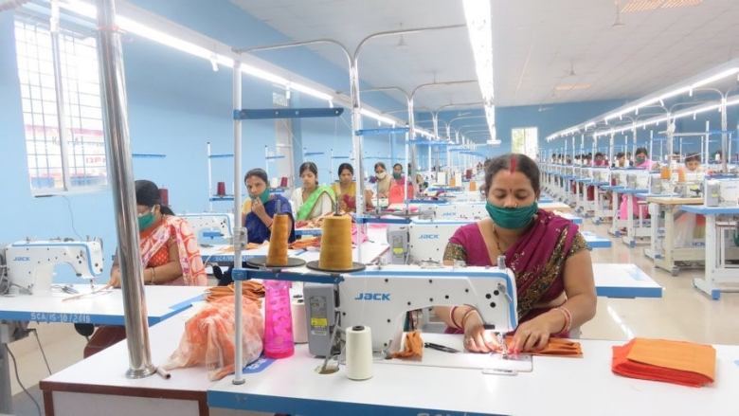
Self Help Group

Slide 72
Recap
In this topic, we have studied the concept and role of self-help groups.

Slide 73
Daily Quiz
Define self-help groups.
Explain the functioning of self-help groups.
Is Self-help group an enterprise?
True
False

Slide 74
Weekly Assignment
Select a village and find out the involvement of people in self-help groups, financial institutions and community based organisations in the village.
Make a PowerPoint presentation on the Panchayati raj system and find the gaps that needs to be addressed for holistic development of people in rural setup.

Slide 75
Topic Links
https://www.drishtiias.com/important-institutions/drishti-specials-important-institutions-national-institutions/panchayati-raj-institution-pri#:~:text=Panchayati%20Raj%20Institution%20%28PRI%29%20is%20a%20system%20of,who%20have%20been%20elected%20by%20the%20local%20people.
https://www.youtube.com/watch?v=mW4Dbtn6GvU
https://www.youtube.com/watch?v=lcQWQWf5XiU
https://www.youtube.com/watch?v=l1avvy1WwNA

Slide 76
MCQ
At which level does Zila Parishad actually make development plans?
District level
Panchayat Samiti
Block level
Government level
Answer: A
2. Who elects the Panchayat Head?
All members of Gram Sabha
Villagers
Secretary
All of these
Answer: A

Slide 77
MCQ
3. Which of the following are voluntary provisions as per the 73rd Constitutional Amendment Act of 1992?
1) Providing representation to members of the Parliament and State Legislature in the Panchayats.
2) Devolution of powers and responsibilities upon Panchayats.
3) Organization of Gram Sabha.
4) None of these
a. Only 1
b. 1 and 3
c. 1 and 2
d. All of the above
Answer: c

Slide 78
MCQ
4. Which of the following is/are true regarding Panchayati Raj system?
1) The act won’t apply to Darjeeling district of West Bengal.
2) Allotment of seats in constituencies for Panchayat elections cannot be questioned in any court of law.
a. Only 1
b. Only 2
c. Both 1 and 2
d. None of the above
Answer: c
5. Which of the following Amendments to Constitution of India grants a Constitutional status to 'Panchayati Raj System’?
71th Amendment
72nd Amendment
73rd Amendment
75th Amendment
Answer: C

Slide 79
Glossary Questions
Zila Parishad make development plans at ______ level.
_____ amendment to Constitution of India grants a Constitutional status to 'Panchayati Raj System’.
The three-tier system of local government does NOT include the _________.
The State Finance Commission is a _________.
Article ________ directs the State Governments to organize the Panchayats.
Village committee
Constitutional body
40
73rd
District

Slide 80
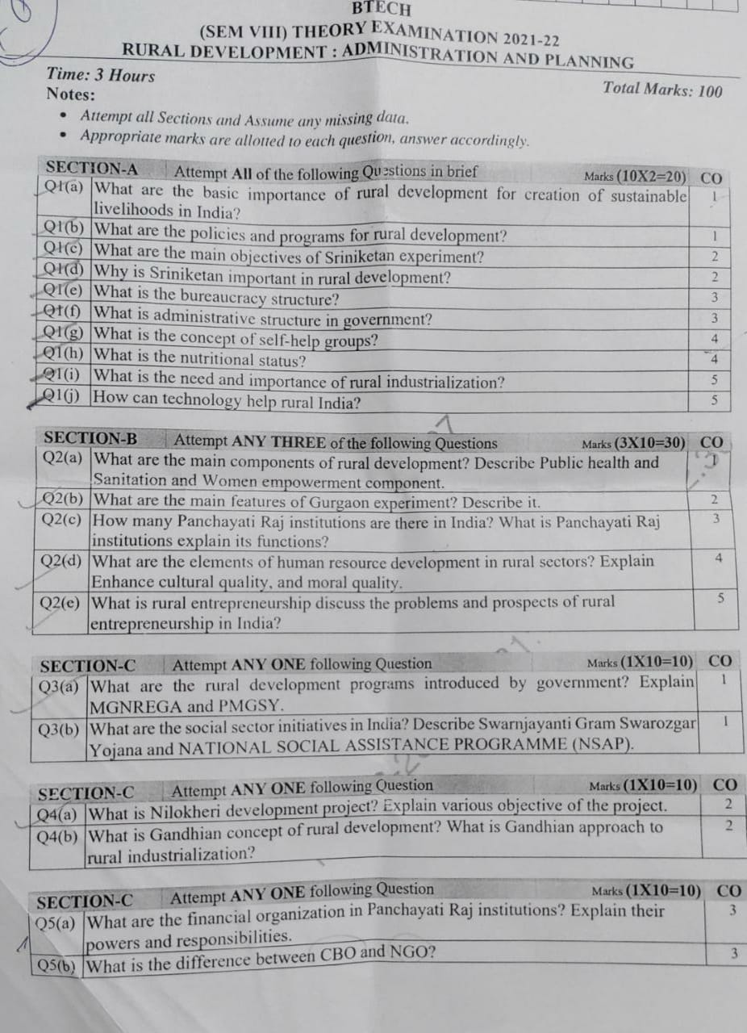
Previous Question Paper

Slide 81
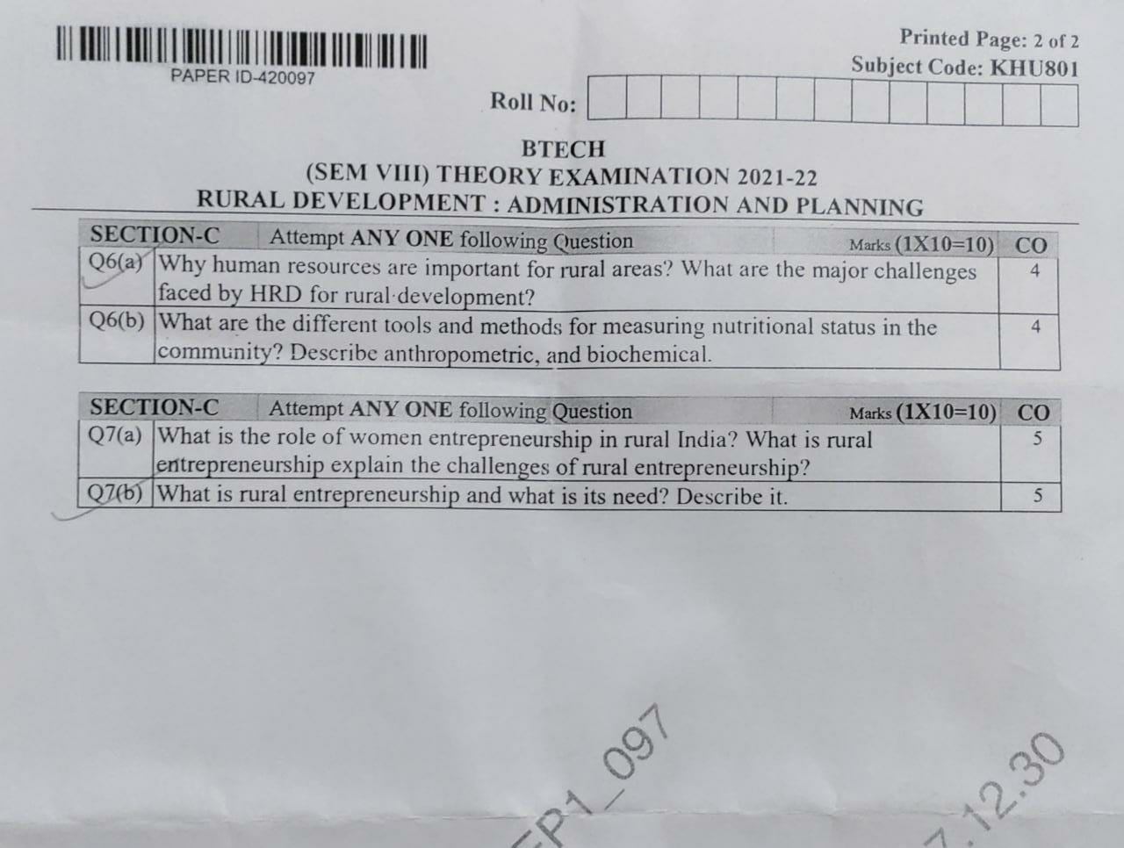
Previous Question Paper

Slide 82
Expected questions
Elaborate the objectives of community based organization.
Highlight the inception of community based organizations.
State the three levels of Panchayati raj structure.
Make a flow chart to explain the bureaucratic model of Panchayati raj in India.
Elaborate the three-tier structure of Panchayati Raj institutions in India.
Highlight the emergence and growth of Panchayati Raj institutions.

Slide 83
Recap of Unit
Panchayati Raj is a system of rural local self-government in India.
Self Help Groups are groups of 10-20 people in a locality formed for any social or economic purpose.
Community Development had a long history in India even before the launching of the Community Development Programme (CDP) during the period of 2nd October 1952.
The finances of Gram Panchayat come from both the state and the federal government. Grants from the Central Finance Commission are currently one of the most important sources of funds for Gram Panchayats

